Slide 1
Data Flow Diagram

Slide 2
DATA FLOW DIAGRAMS [DFD’S]
A diagram to show how data is captured, processed , stored and distributed within a system.
This is generally represented during the analysis stage of a project, but can be further refined during the design stage to show more detail of how the system functions.

Slide 3
Identifying Data Flows
During the analysis stage of a project it is important to find out how data flows through a system:
Where does the data originate
What processing is performed on it and by whom
Who uses the data
What data is stored and where
What output is produced and who receives it

Slide 4
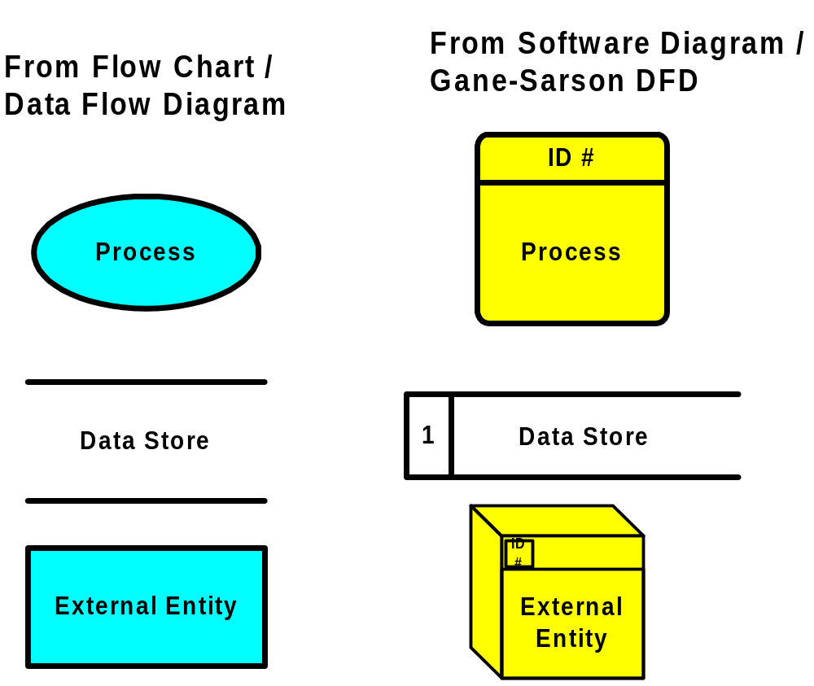
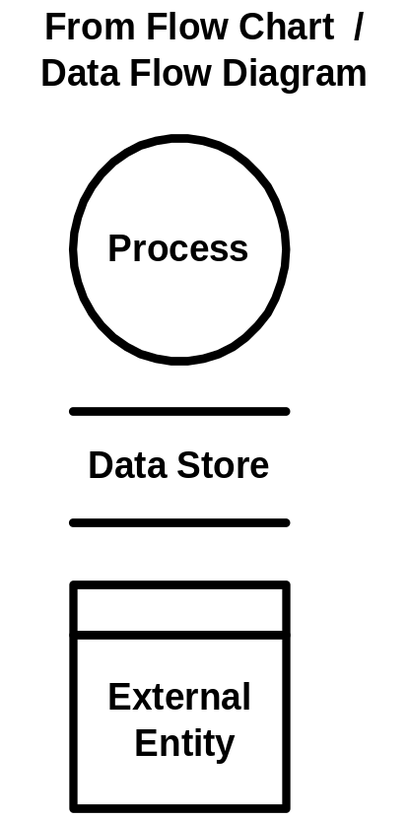
DFD Shapes
Visio 5.x
Visio 2000

Slide 5
SYMBOLS USED IN A DFD
PROCESS
Actions performed on data so that they are transformed, stored or distributed. This can be a computerised or manual transformation
DATA FLOW
E.g. Result of a query to a database, contents of a printed report : data that moves together to common destinations

Slide 6
SYMBOLS USED IN A DFD
DATA STORE
A physical location to hold data e.g. a file folder or notebook etc.
SOURCE/SINK
Origin and/or destination of the data. Often referred to as external entities as they are outside the system. We are only interested in how data flows in to or from the system to them.

Slide 7
External Entities
Represent people or organizations outside of the system being studied
Shows the initial source and final recipient of data and information
Should be named with a noun, describing that entity
Customer

Slide 8
External Entities (Continued)
External entities may be:
  A person, such as CUSTOMER or STUDENT.
  A company or organization, such as BANK or SUPPLIER.
  Another department within the company, such as ORDER FULFILLMENT.
  Another system or subsystem, such as the INVENTORY CONTROL SYSTEM.

Slide 9

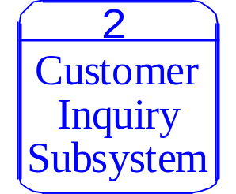
Processes
Represent either:
  A whole system
  A subsystem
  Work being done, an activity
Names should be in the form verb-adjective-noun
  The exception is a process that represents an entire system or subsystem.

Slide 10

Data Stores
Name with a noun, describing the data
Data stores are usually given a unique reference number, such as D1, D2, D3.
Include any data stored, such as:
  A computer file or database.
  A transaction file .
  A set of tables .
  A manual file of records.

Slide 11


Data Flow
Data flow shows the data about a person, place, or thing that moves through the system.
Names should be a noun that describes the data moving through the system.
Arrowhead indicates the flow direction.
Use double headed-arrows only when a process is reading data and updating the data on the same table or file.

Slide 12
How Much Detail ?
It is often impossible to represent a complete business on one diagram. For this reason it is quite common to use more than one level of Data Flow Diagram with each level showing more detailed information about part of the previous diagram.
It is important that the diagram should be made as clear as possible and for this reason it is not uncommon to draw the same source or sink [external entity] more than once to help achieve this.

Slide 13
Context or Level 0 Diagram
The highest level view of a system. This only has one process which represents the overall function of the system and has no data stores as all the data is stored within the process.
Main steps when constructing a Level 0 Diagram :
Identify where data is captured from
Identify where data is distributed to
Describe the overall process
Map these out in a diagram using the correct symbols
Link them with data flows that are labelled

Slide 14
Constructing a Level 1 diagram
Identify and draw the processes that make up the Level 0 process
Allocate descriptions to these
Lay out the sources/sinks and data flows from the Level 0 diagram
Draw in any data stores used in the process
Link the new processes and data stores with named data links

Slide 15
Constructing a Level 2/3 diagram
IF it is necessary to produce a level 2 or level 3 diagram, the same steps would be followed as used when constructing the Level 1 diagram

Slide 16
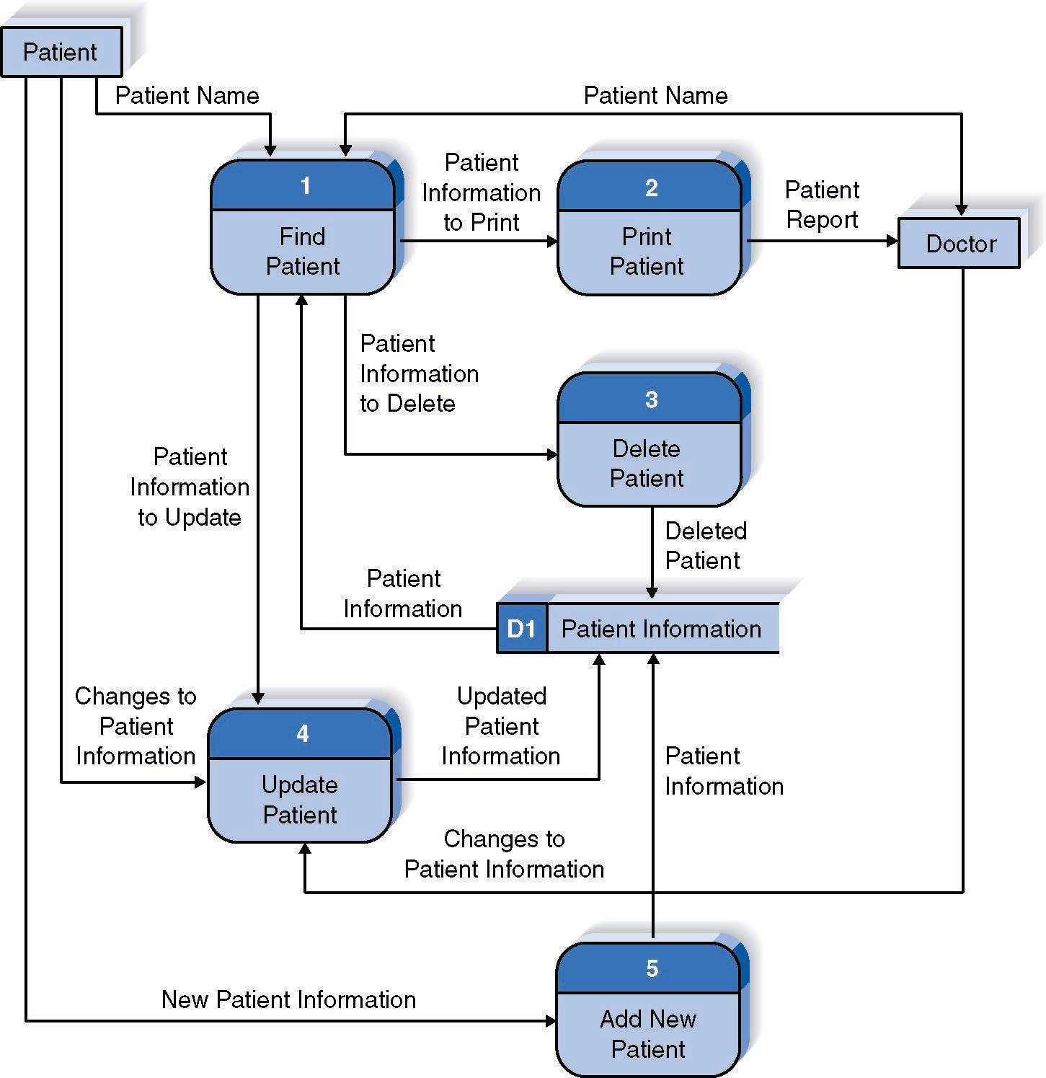
Example:

Slide 17
Here is an example of how Data flow diagrams would be used to model the logic of data flows in a fast food burger bar.
. Context or Level 0 Diagram
Identify where data is captured from
Identify where data is distributed to
Describe the overall process
Map these out in a diagram using the correct symbols
Link them with data flows that are labelled

Slide 18
Level 0 Context diagram
CUSTOMER

Slide 19
Identify where data is captured from
Identify where data is distributed to
Describe the overall process
Map these out in a diagram using the correct symbols
Link them with data flows that are labelled

Slide 20
Level 0 Context diagram
CUSTOMER
KITCHEN
RESTAURANT MANAGER

Slide 21
Identify where data is captured from
Identify where data is distributed to
Describe the overall process
Map these out in a diagram using the correct symbols
Link them with data flows that are labelled

Slide 22
Level 0 Context diagram
CUSTOMER
KITCHEN
0
Food ordering system
RESTAURANT MANAGER

Slide 23
Identify where data is captured from
Identify where data is distributed to
Describe the overall process
Map these out using the correct symbols
Link them with data flows that are labelled

Slide 24
Level 0 Context diagram
CUSTOMER
KITCHEN
0
Customer Order
Food ordering system
Food Order
Receipt
Management Reports
RESTAURANT MANAGER

Slide 25
Constructing a Level 1 diagram
Identify and draw the processes that make up the Level 0 process
Allocate descriptions to these
Lay out the sources/sinks and data flows from the Level 0 diagram
Draw in any data stores used in the process
Link the new processes and data stores with named data links

Slide 26
Level 0 Context diagram
CUSTOMER
KITCHEN
0
Customer Order
Food ordering system
Food Order
Receipt
Management Reports
Does this show enough detail?
RESTAURANT MANAGER

Slide 27
Constructing a Level 1 diagram
Identify and draw the processes that make up the Level 0 process
Allocate descriptions to these
Lay out the sources/sinks and data flows from the Level 0 diagram
Draw in any data stores used in the process
Link the new processes and data stores with named data links

Slide 28
Level 1 diagram
These new processes may show a process which corresponds to actions such as :
Capturing data from different sources
Maintaining data stores
Producing and distributing data to different sinks

Slide 29
1.0
Receive and transform Customer Food Order

Slide 30
Level 1 diagram
These may show a process which corresponds to actions such as :
Capturing data from different sources
Maintaining data stores
Producing and distributing data to different sinks

Slide 31
1.0
Receive and transform Customer Food Order
3.0
2.0
Update Goods Sold file
Update Inventory file

Slide 32
Level 1 diagram
These may show a process which corresponds to actions such as :
Capturing data from different sources
Maintaining data stores
Producing and distributing data to different sinks

Slide 33
1.0
Receive and transform Customer Food Order
3.0
2.0
Update Goods Sold file
Update Inventory file
4.0
Produce Management Reports

Slide 34
Constructing a Level 1 diagram
Identify and draw the processes that make up the Level 0 process
Allocate descriptions to these
Lay out the sources/sinks and data flows from the Level 0 diagram
Draw in any data stores used in the process
Link the new processes and data stores with named data links

Slide 35
CUSTOMER
KITCHEN
1.0
Customer Order
Receive and transform Customer Food Order
Food Order
Receipt
3.0
2.0
Update Goods Sold file
Update Inventory file
4.0
Produce Management Reports
RESTAURANT MANAGER
Management Reports

Slide 36
Constructing a Level 1 diagram
Identify and draw the processes that make up the Level 0 process
Allocate descriptions to these
Lay out the sources/sinks and data flows from the Level 0 diagram
Draw in any data stores used in the process
Link the new processes and data stores with named data links

Slide 37
CUSTOMER
KITCHEN
1.0
Customer Order
Receive and transform Customer Food Order
Food Order
Receipt
3.0
2.0
Update Goods Sold file
Update Inventory file
Goods Sold File
D2
Inventory File
D1
4.0
Produce Management Reports
RESTAURANT MANAGER
Management Reports

Slide 38
Constructing a Level 1 diagram
Identify and draw the processes that make up the Level 0 process
Allocate descriptions to these
Lay out the sources/sinks and data flows from the Level 0 diagram
Draw in any data stores used in the process
Link the new processes and data stores with named data links

Slide 39
CUSTOMER
KITCHEN
1.0
Customer Order
Receive and transform Customer Food Order
Food Order
Receipt
Goods
Sold
Inventory
Data
3.0
2.0
Update Goods Sold file
Update Inventory file
Inventory Data
Goods Sold Data
Goods Sold File
D2
Inventory File
D1
4.0
Produce Management Reports
Daily Goods Sold Amount
Daily Inventory Depletion Amounts
RESTAURANT MANAGER
Management Reports

Slide 40
In this example, having constructed our Level 1 diagram it is decided there is no need to further breakdown the data flow processes within this organisation. Our data flow diagram is therefore complete.

Slide 41
Do’s and Don’ts when constructing a Data Flow Diagram
✓
✓

Slide 42
Do’s and Don’ts when constructing a Data Flow Diagram
✓
✓

Slide 43
Do’s and Don’ts when constructing a Data Flow Diagram
✓
✓

Slide 44
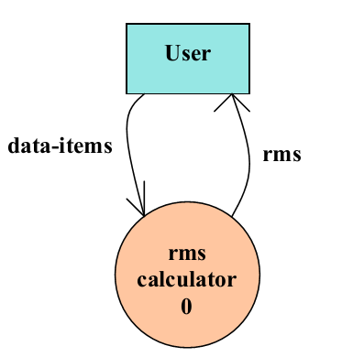
RMS Calculating Software.
A software system called RMS calculating software would read three integral numbers from the user in the range of -1000 and +1000 and then determine the root mean square (rms) of the three input numbers and display it.
The system accepts three integers from the user and returns the result to him.
Context Diagram/Level )

Slide 45
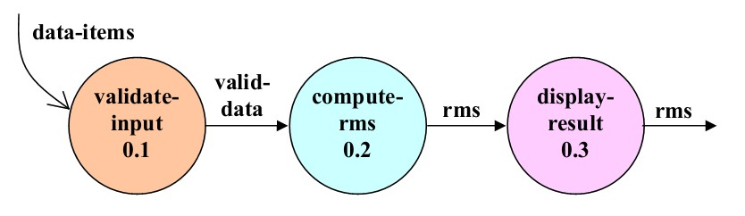
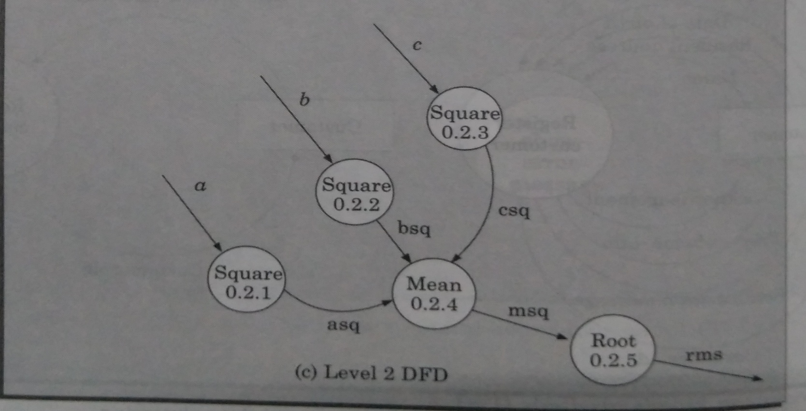
Level 1

